Slide 1
DS503 Machine Learning for Data Science (Introduction & Revision)
Instructor:
Muhammad Shahzad

Slide 2
Contents
Introduction
Applications
Types of Machine Learning
Conclusions

Slide 3
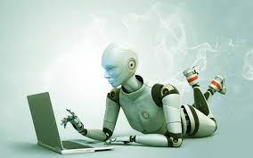
Introduction
Machine learning:
Grew out of work in AI
New capability for computers
Field of study that gives computers ability to learn
Notes:
I

Slide 4
Introduction
Arthur Samuel (1959). Machine Learning: Field of
study that gives computers the ability to learn without being explicitly programmed.
Now what is meant by computers ability to learn
Tom Mitchell (1998): A computer program is said to learn from experience E with respect to some task T and some performance measure P, if its performance on T, as measured by P, improves with E

Slide 5
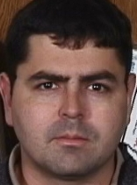
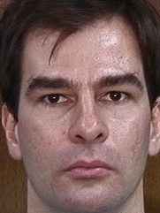
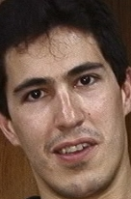


Example
Task: Face Recognition
Experience: Images or Examples
Performance Measure: Accuracy
Training Data
??

Slide 6
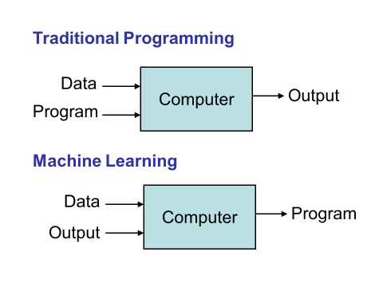
TP vs ML

Slide 7
Some Applications
predict whether a patient, hospitalized due to heart attack, will have a second heart attack
predict the price of a stock in 6 months from now
Autonomous helicopter, handwriting recognition, most of
Natural Language Processing (NLP), Computer Vision.
Personalized Medicine
face detection, spam filtering: identify email messages as spam or non-spam
Self-customizing programs: E.g., Amazon, Netflix product recommendations

Slide 8


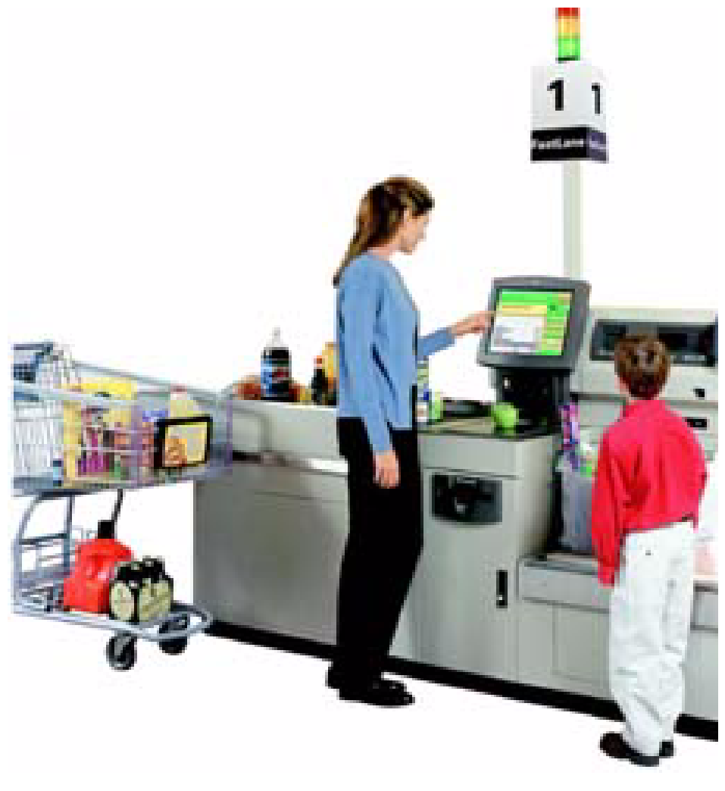
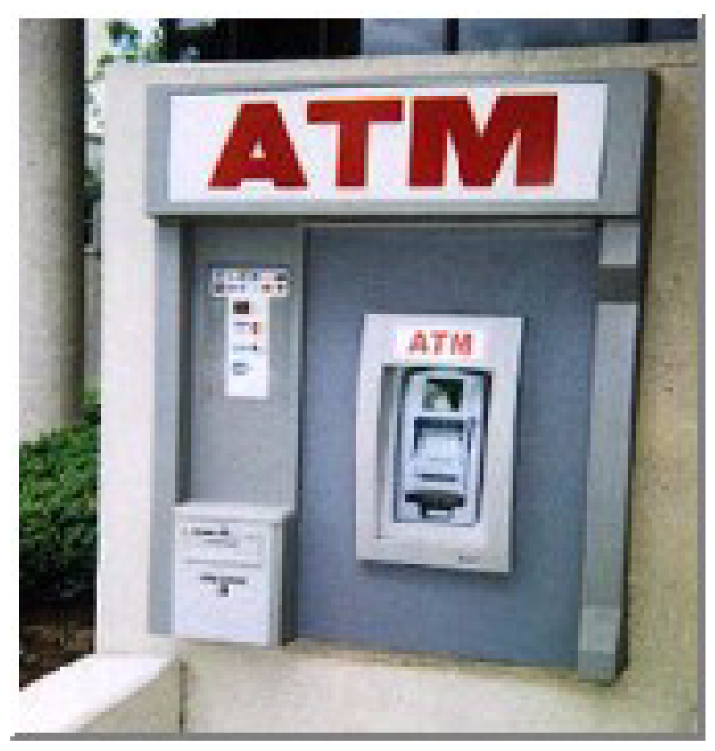
Why Mine Data? Commercial Viewpoint
Lots of data is being collected and warehoused
Web data, e-commerce
purchases at department/ grocery stores
Bank/Credit Card transactions
Computers have become cheaper and more powerful
Notes:
Before I discuss some applications, I would like to mention that we are using learning methods in our daily life without knowing it. e.g. Royal mail service recognize the postal code i.e. Character recognition using learning methods; so everything u send mail; u are using learning algorithms; perhaps even not aware of it. Another example is when we use websites such as amazon they often recommend books to buy or CDs to buy. This is another example of learning algorithm that tries to learn what are u interested on; what sort of movies would u like to watch and thus customize recommendation according to that.

Slide 9
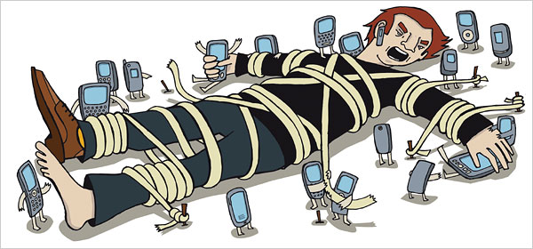
Data Everywhere
Notes:
Before I discuss some applications, I would like to mention that we are using learning methods in our daily life without knowing it. e.g. Royal mail service recognize the postal code i.e. Character recognition using learning methods; so everything u send mail; u are using learning algorithms; perhaps even not aware of it. Another example is when we use websites such as amazon they often recommend books to buy or CDs to buy. This is another example of learning algorithm that tries to learn what are u interested on; what sort of movies would u like to watch and thus customize recommendation according to that.

Slide 10
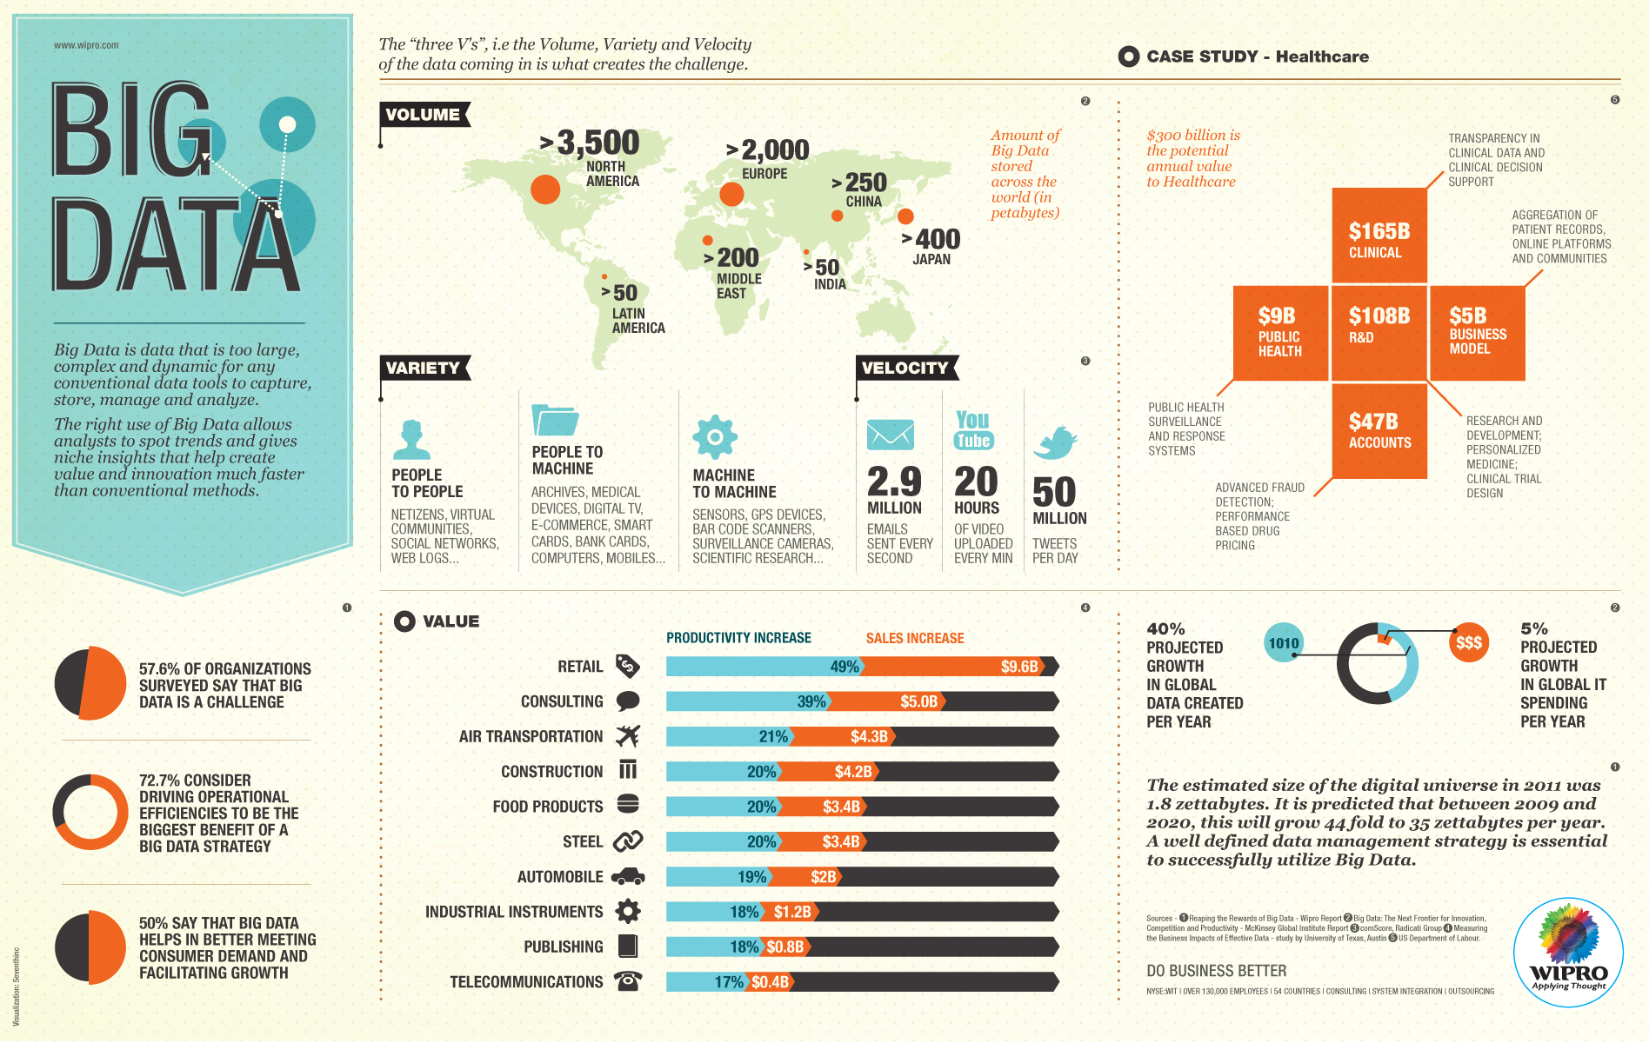

Slide 11
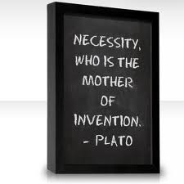
OK , there is too much Data, then WHAT?
Can we use this data to find things that are not apparent but can be very useful to us?
We are drowning in data, but starving for knowledge!
Knowledge Discovery is needed to make sense and use of data.

Slide 12
ML in a Nutshell
Tens of thousands of machine learning algorithms
Hundreds new every year
Every machine learning algorithm has three components:
Representation
Evaluation
Optimization

Slide 13
Representation
Decision trees
Sets of rules / Logic programs
Instances
Graphical models (Bayes/Markov nets)
Neural networks
Support vector machines
Model ensembles
Etc.

Slide 14
Evaluation
Accuracy
Precision and recall
Squared error
Likelihood
Posterior probability
Cost / Utility
Margin
Entropy
Etc.

Slide 15
Optimization
Combinatorial optimization
E.g.: Greedy search
Convex optimization
E.g.: Gradient descent
Constrained optimization
E.g.: Linear programming

Slide 16
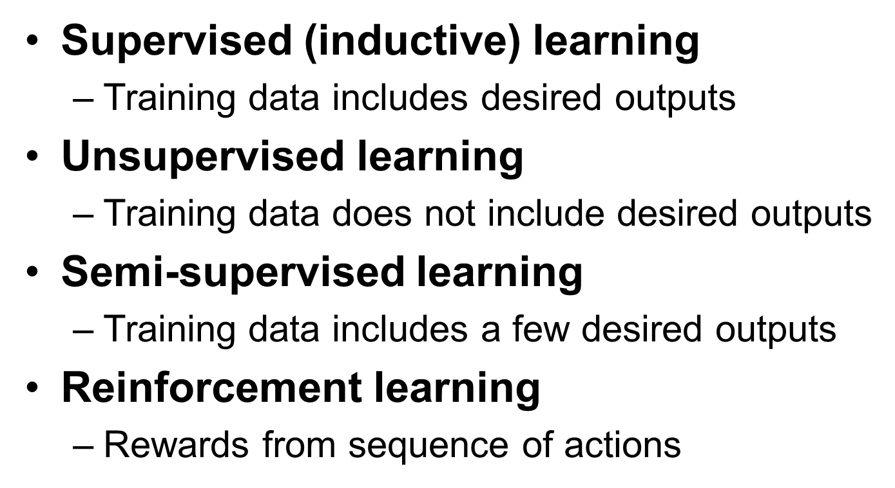
Types of Learning
Machine Learning
Supervised
Unsupervised
Semi Supervised
Reinforcement

Slide 17
Inductive Learning
Given examples of a function (X, F(X))
Predict function F(X) for new examples X
Discrete F(X): Classification
Continuous F(X): Regression
F(X) = Probability(X): Probability estimation

Slide 18
Supervised Learning
Supervised Learning
Learn from Supervised Training Data
For example; spam filtering where Large number of email messages labelled as either
spam
non-spam
New email message will then be classified as spam or non-spam
Notes:
Machine Learning method able to extract rules from this data

Slide 19
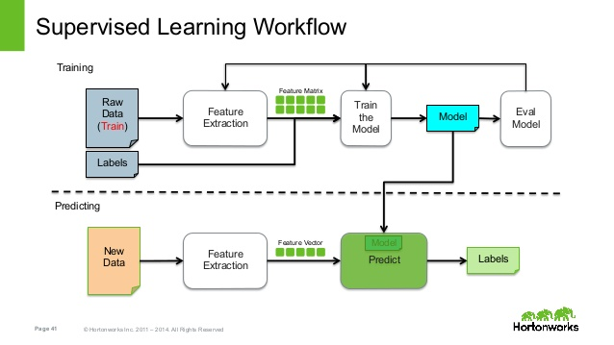
Notes:
Machine Learning method able to extract rules from this data

Slide 20
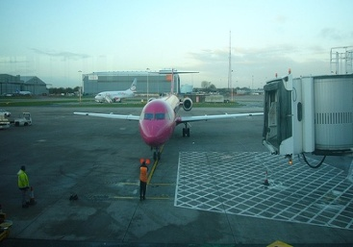
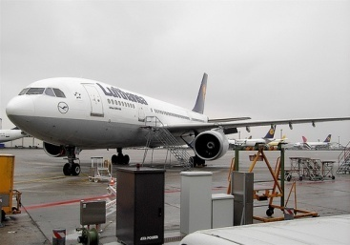
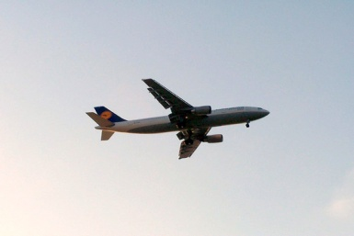



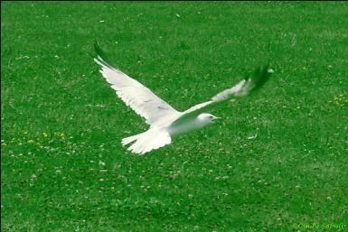
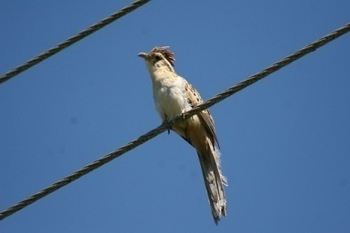

Supervised Learning
Training Images
Test Image
Notes:
Machine Learning method able to extract rules from this data

Slide 21
Unsupervised Learning
The correct classes of training data are not known
Applications
Fraud Detection: Identify groups of motor insurance policy holders with a high average claim cost
Social Networks: Recognize communities within large groups of people

Slide 22
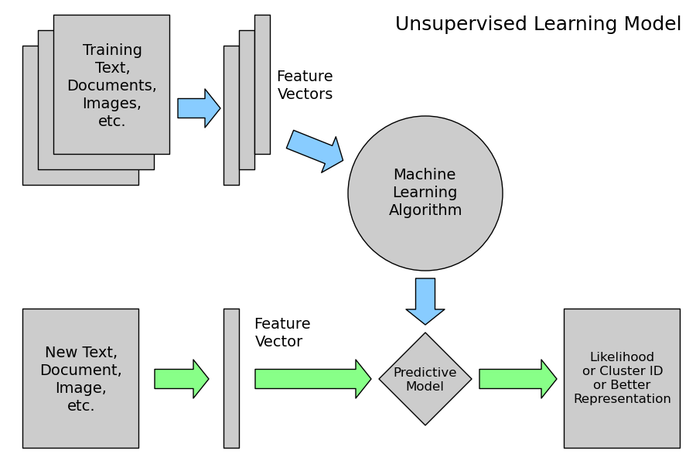
Unsupervised Learning

Slide 23
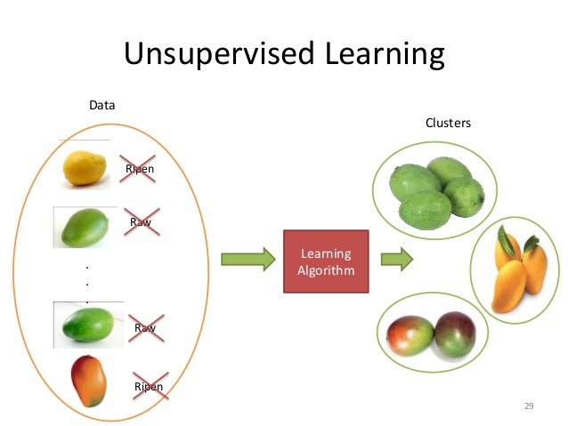
Unsupervised Learning

Slide 24

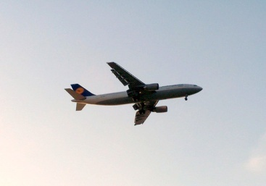


Unsupervised Learning
Objective is simply to divide above Images into N groups
Here ideally N = 2
Notes:
Here the method can also assum other groups e.g. Group with one object or group with multiple objects

Slide 25
Reinforcement Learning
Allows the machine to learn its behaviour based on feedback from the environment
Applications: Card Games, Chess etc

Slide 26
What we will Cover
Supervised learning
Decision tree induction
Rule induction
Instance-based learning
Neural networks
Support vector machines
Model ensembles
Unsupervised learning
Clustering
Dimensionality reduction

Slide 27
ML in Practice
Understanding domain, prior knowledge, and goals
Data integration, selection, cleaning, pre-processing, etc.
Learning models
Interpreting results
Consolidating and deploying discovered knowledge
Loop

Slide 28
Tools
Java (WEKA)
Matlab
C++
Phyton
Apache Spark (For Clouds)
R
Notes:
Computer Vision e.g. Face detection, Image Retrieval
Biomedical e.g. Diagnose a patient with a disease
Finance e.g. Credit Card Transactions which may be suspecious in nature
Computer Games e.g. Play with Computers e.g. Chess
Mobile Application Development: e.g. Replacing 4 digit security key with Biometric; develop applications to identify certain disease etc

Slide 29

WHAT IS THIS COURSE ALL ABOUT ?

Slide 30
Course Description
This course is about gaining an understanding of machine learning problems and their solutions.
This course will not only provide the students a comprehension of the benefits of machine learning, but also provide them with an understanding of the types of problems and their associated solutions.
It will also impart them skills for pre-processing of data and post-processing of results.

Slide 31
Course Main Learning Objectives
Have knowledge of the importance and benefits of machine learning
Have knowledge and understanding of machine learning problems and their solutions
Have an understanding of machine learning algorithms,
Have knowledge of the commonly used tools and techniques of machine learning
Understand how data has to be pre-processed before application of machine learning algorithms
Understand how to analyse and use the results obtained from the algorithms.

Slide 32
HOW WILL BE GRADING DONE? : THE Grading Scheme
Midterm 15%
Project & Presentation 20%
Homeworks 15%
Final 50%

Slide 33
Final Remarks
12 IT skills that employers can't say no to (ComputerWorld)
Number one is Machine Learning
“There are lots of applications that have big, big, big data sizes, which creates a fundamental problem of how you organize the data and present it to users”
Notes:
Computer Vision e.g. Face detection, Image Retrieval
Biomedical e.g. Diagnose a patient with a disease
Finance e.g. Credit Card Transactions which may be suspecious in nature
Computer Games e.g. Play with Computers e.g. Chess
Mobile Application Development: e.g. Replacing 4 digit security key with Biometric; develop applications to identify certain disease etc

Slide 34
References
Some slides taken from Dr. Atif Tahir Lecture series

Slide 35
Questions!

